Slide 1
GRID COMPUTING – AN INTRODUCTION

Slide 2
Outline
Introduction to Grid Computing
Methods of Grid computing
Grid Middleware
Grid Architecture

Slide 3
Grid Computing
Grid computing is a form of distributed computing whereby a "super and virtual computer" is composed of a cluster of networked, loosely coupled computers, acting in concert to perform very large tasks.
Grid computing (Foster and Kesselman, 1999) is a growing technology that facilitates the executions of large-scale resource intensive applications on geographically distributed computing resources.
Facilitates flexible, secure, coordinated large scale resource sharing among dynamic collections of individuals, institutions, and resource
Enable communities (“virtual organizations”) to share geographically distributed resources as they pursue common goals
Ian Foster and Carl Kesselman

Slide 4
Criteria for a Grid:
Coordinates resources that are not subject to centralized control.
Uses standard, open, general-purpose protocols and interfaces.
Delivers nontrivial qualities of service.
Benefits
Exploit Underutilized resources
Resource load Balancing
Virtualize resources across an enterprise
Data Grids, Compute Grids
Enable collaboration for virtual organizations

Slide 5
Grid Applications
Data and computationally intensive applications:
This technology has been applied to computationally-intensive scientific, mathematical, and academic problems like drug discovery, economic forecasting, seismic analysis back office data processing in support of e-commerce
A chemist may utilize hundreds of processors to screen thousands of compounds per hour.
Teams of engineers worldwide pool resources to analyze terabytes of structural data.
Meteorologists seek to visualize and analyze petabytes of climate data with enormous computational demands.
Resource sharing
Computers, storage, sensors, networks, …
Sharing always conditional: issues of trust, policy, negotiation, payment, …
Coordinated problem solving
distributed data analysis, computation, collaboration, …

Slide 6
Grid Topologies
• Intragrid
– Local grid within an organisation
– Trust based on personal contracts
• Extragrid
– Resources of a consortium of organisations
connected through a (Virtual) Private Network
– Trust based on Business to Business contracts
• Intergrid
– Global sharing of resources through the internet
– Trust based on certification

Slide 7
Computational Grid
“A computational grid is a hardware and software infrastructure that provides dependable, consistent, pervasive, and inexpensive access to high-end computational capabilities.”
”The Grid: Blueprint for a New Computing Infrastructure”, Kesselman & Foster
Example : Science Grid (US Department of Energy)

Slide 8
Data Grid
A data grid is a grid computing system that deals with data — the controlled sharing and management of large amounts of distributed data.
Data Grid is the storage component of a grid environment. Scientific and engineering applications require access to large amounts of data, and often this data is widely distributed. A data grid provides seamless access to the local or remote data required to complete compute intensive calculations.
Example :
Biomedical informatics Research Network (BIRN),
the Southern California earthquake Center (SCEC).

Slide 9
Methods of Grid Computing
Distributed Supercomputing
High-Throughput Computing
On-Demand Computing
Data-Intensive Computing
Collaborative Computing
Logistical Networking

Slide 10
Distributed Supercomputing
Combining multiple high-capacity resources on a computational grid into a single, virtual distributed supercomputer.
Tackle problems that cannot be solved on a single system.
Notes:
10

Slide 11
High-Throughput Computing
Uses the grid to schedule large numbers of loosely coupled or independent tasks, with the goal of putting unused processor cycles to work.
On-Demand Computing
Uses grid capabilities to meet short-term requirements for resources that are not locally accessible.
Models real-time computing demands.
Notes:
11

Slide 12
Collaborative Computing
Concerned primarily with enabling and enhancing human-to-human interactions.
Applications are often structured in terms of a virtual shared space.
Data-Intensive Computing
The focus is on synthesizing new information from data that is maintained in geographically distributed repositories, digital libraries, and databases.
Particularly useful for distributed data mining.
Notes:
12

Slide 13
Logistical Networking
Logistical networks focus on exposing storage resources inside networks by optimizing the global scheduling of data transport, and data storage.
Contrasts with traditional networking, which does not explicitly model storage resources in the network.
high-level services for Grid applications
Called "logistical" because of the analogy it bears with the systems of warehouses, depots, and distribution channels.
Notes:
13

Slide 14
P2P Computing vs Grid Computing
Differ in Target Communities
Grid system deals with more complex, more powerful, more diverse and highly interconnected set of resources than P2P.

Slide 15
A typical view of Grid environment
Grid Information Service system collects the details of the available Grid resources and passes the information to the resource broker.
Grid Information Service
Details of Grid resources
1
2
4
3
Computational jobs
Grid application
Processed jobs
Computation result
User
Resource Broker
A User sends computation or data intensive application to Global Grids in order to speed up the execution of the application.
A Resource Broker distribute the jobs in an application to the Grid resources based on user’s QoS requirements and details of available Grid resources for further executions.
Grid Resources
Grid Resources (Cluster, PC, Supercomputer, database, instruments, etc.) in the Global Grid execute the user jobs.

Slide 16
Grid Middleware
Grids are typically managed by grid ware -
a special type of middleware that enable sharing and manage grid components based on user requirements and resource attributes (e.g., capacity, performance)
Software that connects other software components or applications to provide the following functions:
Run applications on suitable available resources
– Brokering, Scheduling
Provide uniform, high-level access to resources
– Semantic interfaces
– Web Services, Service Oriented Architectures
Address inter-domain issues of security, policy, etc.
– Federated Identities
Provide application-level status
monitoring and control

Slide 17
Middlewares
Globus – Chicago Univ
Condor – Wisconsin Univ – High throughput computing
Legion – Virginia Univ – virtual workspaces- collaborative computing
IBP – Internet back pane – Tennesse Univ – logistical networking
NetSolve – solving scientific problems in heterogeneous env – high throughput & data intensive.
Notes:
17

Slide 18
Two Key Grid Computing Groups
The Globus Alliance (www.globus.org)
Composed of people from:
Argonne National Labs, University of Chicago, University of Southern California Information Sciences Institute, University of Edinburgh and others.
OGSA/I standards initially proposed by the Globus Group
The Global Grid Forum (www.ggf.org)
Heavy involvement of Academic Groups and Industry
(e.g. IBM Grid Computing, HP, United Devices, Oracle, UK e-Science Programme, US DOE, US NSF, Indiana University, and many others)
Process
Meets three times annually
Solicits involvement from industry, research groups, and academics

Slide 19
Some of the Major Grid Projects
Name | URL/Sponsor | Focus
EuroGrid, Grid Interoperability (GRIP) | eurogrid.org European Union | Create tech for remote access to super comp resources & simulation codes; in GRIP, integrate with Globus Toolkit™
Fusion Collaboratory | fusiongrid.org DOE Off. Science | Create a national computational collaboratory for fusion research
Globus Project™ | globus.org DARPA, DOE, NSF, NASA, Msoft | Research on Grid technologies; development and support of Globus Toolkit™; application and deployment
GridLab | gridlab.org European Union | Grid technologies and applications
GridPP | gridpp.ac.uk U.K. eScience | Create & apply an operational grid within the U.K. for particle physics research
Grid Research Integration Dev. & Support Center | grids-center.org NSF | Integration, deployment, support of the NSF Middleware Infrastructure for research & education

Slide 20
Grid Architecture

Slide 21
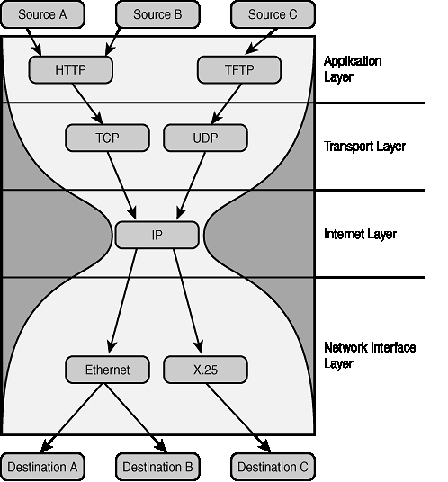
The Hourglass Model
Focus on architecture issues
Propose set of core services as basic infrastructure
Used to construct high-level, domain-specific solutions (diverse)
Design principles
Keep participation cost low
Enable local control
Support for adaptation
“IP hourglass” model
A p p l i c a t i o n s
Diverse global services
Core
services
Local OS

Slide 22
Layered Grid Architecture (By Analogy to Internet Architecture)
Application
Application
Internet Protocol Architecture
“Coordinating multiple resources”: ubiquitous infrastructure services, app-specific distributed services.
Collective
“Sharing single resources”: negotiating access, controlling use.
Resource
“Talking to things”: communication (Internet protocols) & security.
Connectivity
Transport
Internet
“Controlling things locally”: Access to, & control of, resources.
Fabric
Link
Notes:
We define Grid architecture in terms of a layered collection of protocols.
Fabric layer includes the protocols and interfaces that provide access to the resources that are being shared, including computers, storage systems, datasets, programs, and networks. This layer is a logical view rather then a physical view. For example, the view of a cluster with a local resource manager is defined by the local resource manger, and not the cluster hardware. Likewise, the fabric provided by a storage system is defined by the file system that is available on that system, not the raw disk or tapes.
The connectivity layer defines core protocols required for Grid-specific network transactions. This layer includes the IP protocol stack (system level application protocols [e.g. DNS, RSVP, Routing], transport and internet layers), as well as core Grid security protocols for authentication and authorization.
Resource layer defines protocols to initiate and control sharing of (local) resources. Services defined at this level are gatekeeper, GRIS, along with some user oriented application protocols from the Internet protocol suite, such as file-transfer.
Collective layer defines protocols that provide system oriented capabilities that are expected to be wide scale in deployment and generic in function. This includes GIIS, bandwidth brokers, resource brokers,….
Application layer defines protocols and services that are parochial in nature, targeted towards a specific application domain or class of applications. These are are are … arrgh

Slide 23
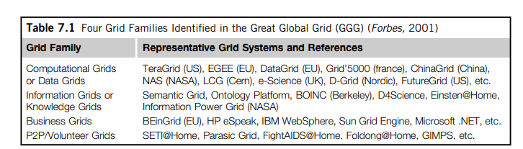
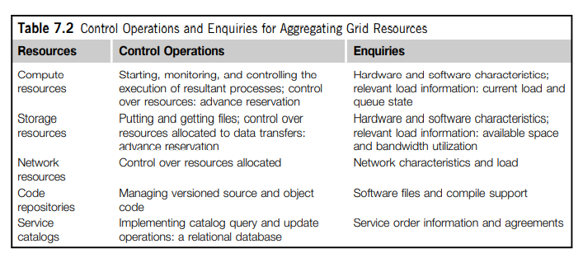

Slide 24
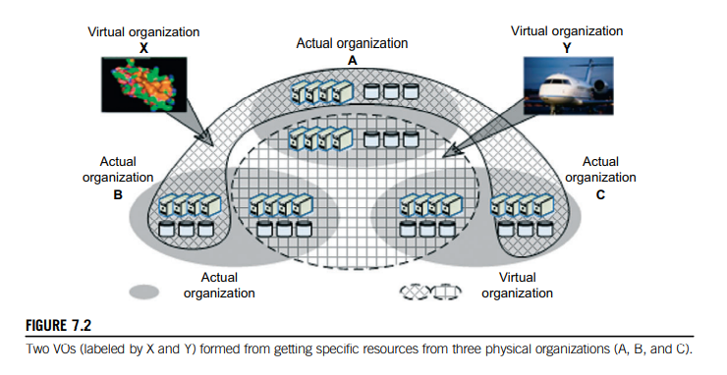

Slide 25
Example: Data Grid Architecture
App
Discipline-Specific Data Grid Application
Collective
(App)
Coherency control, replica selection, task management, virtual data catalog, virtual data code catalog, …
Collective
(Generic)
Replica catalog, replica management, co-allocation, certificate authorities, metadata catalogs,
Resource
Access to data, access to computers, access to network performance data, …
Connect
Communication, service discovery (DNS), authentication, authorization, delegation
Fabric
Storage systems, clusters, networks, network caches, …

Slide 26
Simulation tools
GridSim – job scheduling
SimGrid – single client multiserver scheduling
Bricks – scheduling
GangSim- Ganglia VO
OptoSim – Data Grid Simulations
G3S – Grid Security services Simulator – security services

Slide 27
Simulation tool
GridSim is a Java-based toolkit for modeling, and simulation of distributed resource management and scheduling for conventional Grid environment.
GridSim is based on SimJava, a general purpose discrete-event simulation package implemented in Java.
All components in GridSim communicate with each other through message passing operations defined by SimJava.

Slide 28
Salient features of the GridSim
It allows modeling of heterogeneous types of resources.
Resources can be modeled operating under space- or time-shared mode.
Resource capability can be defined (in the form of MIPS (Million Instructions Per Second) benchmark.
Resources can be located in any time zone.
Weekends and holidays can be mapped depending on resource’s local time to model non-Grid (local) workload.
Resources can be booked for advance reservation.
Applications with different parallel application models can be simulated.

Slide 29
Salient features of the GridSim
Application tasks can be heterogeneous and they can be CPU or I/O intensive.
There is no limit on the number of application jobs that can be submitted to a resource.
Multiple user entities can submit tasks for execution simultaneously in the same resource, which may be time-shared or space-shared. This feature helps in building schedulers that can use different market-driven economic models for selecting services competitively.
Network speed between resources can be specified.
It supports simulation of both static and dynamic schedulers.
Statistics of all or selected operations can be recorded and they can be analyzed using GridSim statistics analysis methods.

Slide 30
A Modular Architecture for GridSim Platform and Components.
Application, User, Grid Scenario’s input and Results
Appn Conf
Res Conf
User Req
Grid Sc
…
Output
Grid Resource Brokers or Schedulers
GridSim Toolkit
Appn modeling
Res entity
Info serv
Job mgmt
Res alloc
Statis
Resource Modeling and Simulation
Single CPU
SMPs
Clusters
Load
Netw
Reservation
Basic Discrete Event Simulation Infrastructure
SimJava
Distributed SimJava
Virtual Machine
PCs
Workstation
SMPs
Clusters
Distributed Resources

Slide 31
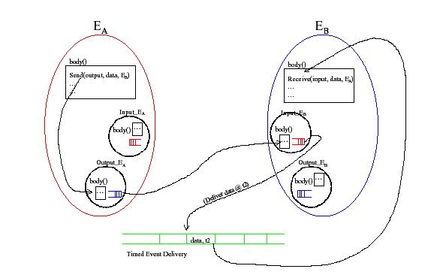

Slide 32
